Slide 1
Earned Income Credit …a refundable credit to low income TP for earning income rather than dependence on social programs
4491-29 Earned Income Credit (EIC) v11.0 VO.pptx
Pub 17 Chapter 35
Pub 4012 Tab H
Notes:
1

Slide 2
Objectives
Determine which taxpayers are eligible
Understand who is a qualifying child
Complete Tax Wise EIC worksheet which will calculate EIC
Notes:
2

Slide 3
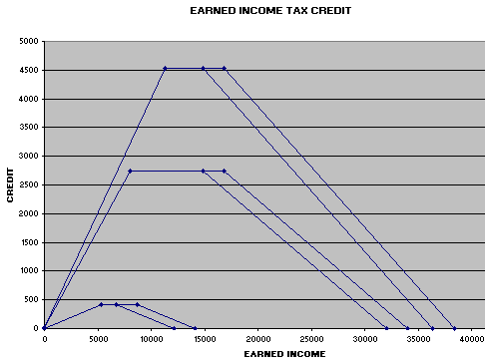
Single/HH – Two Children
MFJ – Two Children
MFJ-One Child
Single/HH-One Child
Single/HH-No Children
MFJ-No Children
MFJ - No Children
Notes:
3

Slide 4
Eligibility
Must have earned income
Common sources:
Wages, salaries and tips
Disability benefits received prior to minimum retirement age
Self employment income
Household employee income
Notes:
4

Slide 5
General Eligibility
Valid SSN
Cannot be MFS
Be citizen or resident alien
Investment income must be less than $3,150
Cannot be qualifying child of another
Under specific AGI and earned income limitations
Notes:
5

Slide 6
EIC Without Children
At least 25 but not 65 or older
Cannot be the dependent of another
Lived in US more than half the year
Lowest allowable credit
Notes:
6

Slide 7
Qualifying Child
Meets qualifying relationship requirements
Qualifying Child does NOT have to be a dependent as support is not an issue
Under 19, under 24 and student, or permanently and totally disabled
Lived with taxpayer over half the year
Must have valid SSN
Notes:
7

Slide 8
Tie-Breaker Rules Pub 4012 Tab H
TaxAide will never invoke Tie-Breaker
That’s an IRS function
Priority order is:
Parent
Parent with whom child lived longest
Parent with highest AGI
If no-one is the parent, person with highest AGI
Notes:
03Filing Status 2008x
8
VRG/ 4012 page 38
Priority order is:
Parent
Parent with whom child lived longest
Parent with highest AGI
If no-one is the parent, person with highest AGI
[This rule is to be used ONLY when there is a contest as to who can claim the child]

Slide 9
Wacky IRS Logic
A nice 65-year-old gentleman earns $5,000 bagging groceries to supplement his bleak existence. He is not entitled to any EIC. Is this correct?
Answer - yes, he is too old to get the EIC. He is 65 years old.
Notes:
9

Slide 10
Wacky IRS Logic
A young father of two earns $15,000 doing hard manual work. He sells his only stock, which he inherited from his mother, and makes a $3,500 capital gain. He uses this money to buy Christmas presents. He is expecting an EIC of about $4,000. Is he correct?
Answer - No, he gets nothing because his investment income is over $3,150
Notes:
10

Slide 11
Complete Tax Wise Worksheet & Calculate EIC
Amount of EIC based on:
Filing status
Number of qualifying children
Higher of earned income or AGI
Tax Wise calculates EIC
Assume children qualify for EIC:
Check “EIC” box opposite child/children on Dependent section of Main Information Sheet
List children from youngest to oldest
Notes:
11

Slide 12
Complete Tax Wise Worksheet & Calculate EIC
Use Tax Wise EIC worksheet
Questions to determine if you can claim EIC
Approximately 15 questions, most already answered from Main Information Sheet
Complete unanswered questions in Red
Figure your credit – Is completed automatically if TP is EIC eligible
Notes:
12

Slide 13
Schedule EIC
Required if TP has qualifying children
Complete unanswered questions that appear in RED
If there are any RED marks on Line 4 (age/disability, answer 4a OR 4b, not both
Do NOT click on any boxes that are not still in RED
Notes:
03Filing Status 2008x
13
In TaxWise, if TP appears to qualify but is not eligible, check box at top of Schedule EIC, eg, when a TP with a qualifying child chooses not to file for EIC With Qualifying Child (another TP with the same qualifying child claims credit), he/she may not then file for EIC Without Qualifying Child.

Slide 14
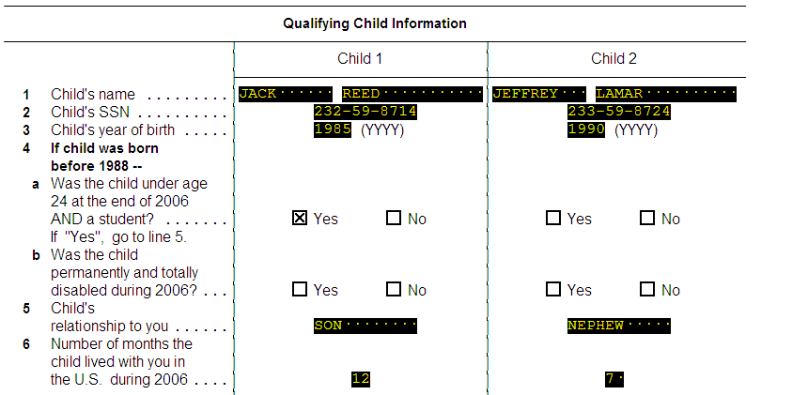
NOTE….
If you check Yes in 4a, AND either Yes or No in 4b, the return will not pass diagnostics.

Slide 15
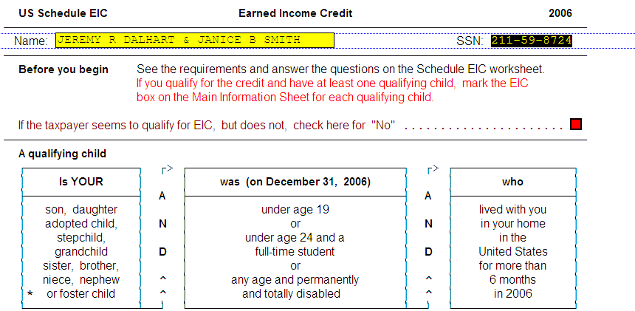
Note….
Do NOT check this box just because it is RED. That will disallow EIC and you’ll never know why.

Slide 16
Disallowed EIC
Form 8862 must be attached to return if prior year EIC claim was denied or reduced for any reason other than a math or clerical error
If math or clerical error, then answer NO to question about disallowed EIC
If claim denied due to reckless or intentional disregard of EIC rules, cannot claim for 2 tax years
If fraud, cannot claim for 10 tax years
Notes:
16

Slide 17
EIC Quiz 1
Sara, 38, earned $5,000
Unmarried child, Jane, age 18, lived with her all year.
Matt, 35 and unrelated, earned $15,000, lived in the home all year.
Matt is not Jane’s father, but provided more than half her support
Who is eligible to claim EIC?
Notes:
17

Slide 18
EIC Quiz 1 - Answer
Jane is Sara’s qualifying child
Sara can claim EIC using Jane
Jane is not Matt’s qualifying child
Matt cannot claim EIC credit for taxpayers without a qualifying child because his income is too high
Notes:
18

Slide 19
EIC Quiz 2
Mike, 40, earned $18,000
Two sons, Joe and George, ages 16 and 18, lived with him all year
Mike’s sister, Susan, 36, earned $11,000
Susan lived with Mike and sons over half the year
Who is eligible to claim EIC?
Notes:
19

Slide 20
EIC Quiz 2 - Answer
Both boys are qualifying children of both Mike and Susan
Mike and Susan can decide who will take which (or both) of the children.
Notes:
20

Slide 21
EIC Quiz 2 – Follow-Up #1
Who would be eligible if Mike and Susan cannot agree who will claim the children?
Mike would be the one eligible for both children because he is their parent.
Notes:
21

Slide 22
EIC Quiz 2 – Follow-Up #2
Who would be eligible if the boys were nephews of both Mike and Susan and they disagreed on who would claim the EIC?
Mike would be the one eligible because he had the higher income.
Notes:
22

Slide 23
EIC QUIZ #3
Bill is 30 years old and earned $33,000; his wife, Emily, is 27 and earned $1000.
Bill and Emily have 3 children under age 19 who lived with both of them until August when they divorced.
The children lived with Emily through the rest of the year.
Who is eligible to claim EIC?

Slide 24
EIC QUIZ #3 ANSWER
EMILY is the one eligible to claim all
The children lived with her the longest (tie-breaker)
She could choose, however, to let Bill claim the children
BILL could claim the children or some of the children if Emily does not claim them (AGI is not an issue between parents, except as a tie-breaker).

